Slide 1


Cloud-Delivered
Inbound Protection
Reducing the attack surface and minimizing risk
NAME | Sales Engineer
Notes:
Thank you very much for having us.
In the next 15-20 minutes, I will walk you through Cato’s True SASE Platform
Let’s make this an interactive conversation. Please feel free to ask questions as I present.
If you would like more technical details or a demo on any of the areas I will cover – we will be happy to provide them.
Let’s start

Slide 2
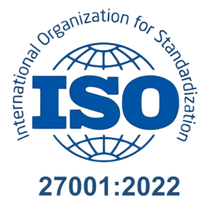
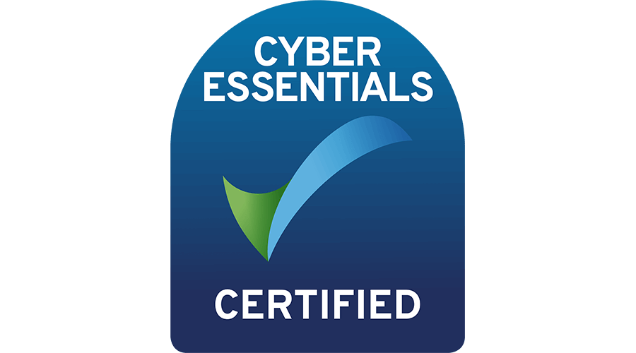
Why do we need Inbound Protection? Compliance
ISO 27001
A standard to establish, implement and maintain information security
NIS2
A framework for the protection of critical infrastructure in the European Union (EU)
Ensure the security and resilience of critical infrastructure and to prevent, deter, and mitigate major accidents
SOC 2
Auditing on controls on security, availability, confidentiality and privacy

Slide 3
Challenges in Achieving Compliance
Audit Evidence
“How check I have controls in place?”
Public Facing
Governance
“How can I protect against attackers whilst ensuring services are running”
“How do ensure I keep to compliance requirements”
Virtual Patching
“Services need to stay active; I can’t afford downtime to patch’
Notes:
Before we get started, I want to share the kind of challenges we see across the IT leaders we speak with.
They cover cost, performance, quality, user experience, and management complexity.
Can you help me understand the primary challenges you face today?

Slide 4
Business Impact of not staying Compliant
Reputational impact
Lowering share value
Industry Regulatory requirements
Financial fines
Not able to sign new customers, business unable to grow at the desired pace
Not able to insure the business against cyber attacks

Slide 5

Cato Networks Remote Port Forwarding
A Secure Way to Publish Services
Cato SPACE engine inspects and secures traffic
Flexible Access Controls enable inbound source filtering
Enables businesses to safely allow for connections into the organisation

Slide 6
Cato Networks Inbound IPS
Ensuring services are up and protected
93.2% of unique CVEs we cover (1,089 out of 1,168) include inbound protection - nearly every CVE we write a signature for protects inbound-facing services
WAF-style signatures are almost entirely inbound - 394/395 rules (SQLi, XSS, XXE, RCE, path traversal, command injection, etc.)
CVE coverage spans 1999-2026 with strong recent growth: 313 inbound rules for 2024 CVEs, 263 for 2025, and 23 for 2026 so far
64 scanner/recon detection rules catch inbound vulnerability scanning

Slide 7
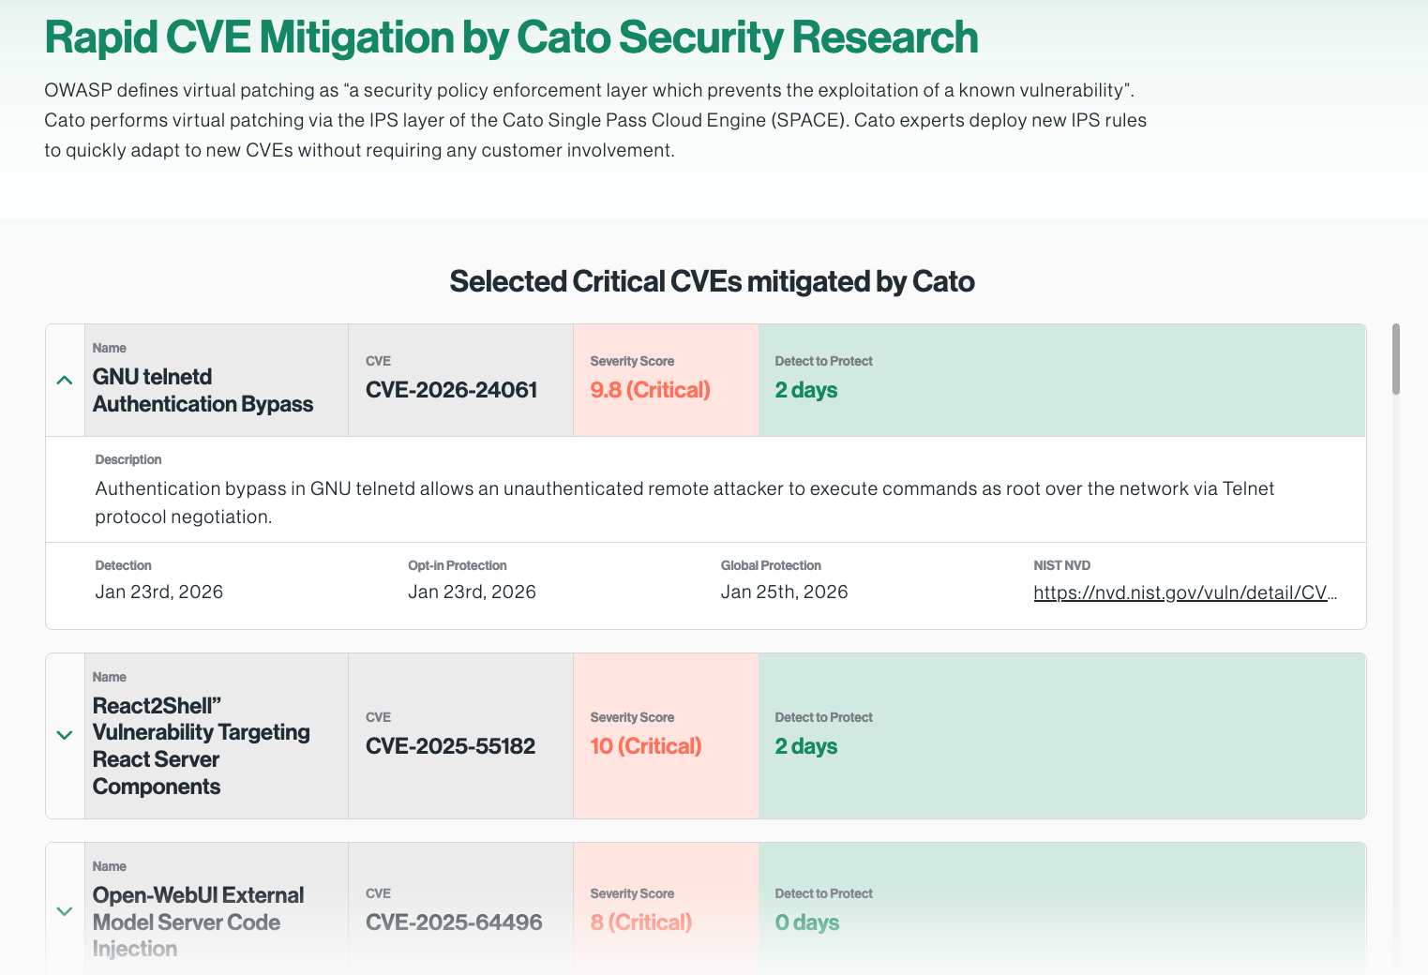
Cato’s Unique Architecture allows for Rapid Mitigation for our Customers
https://www.catonetworks.com/rapid-cve-mitigation/

Slide 8
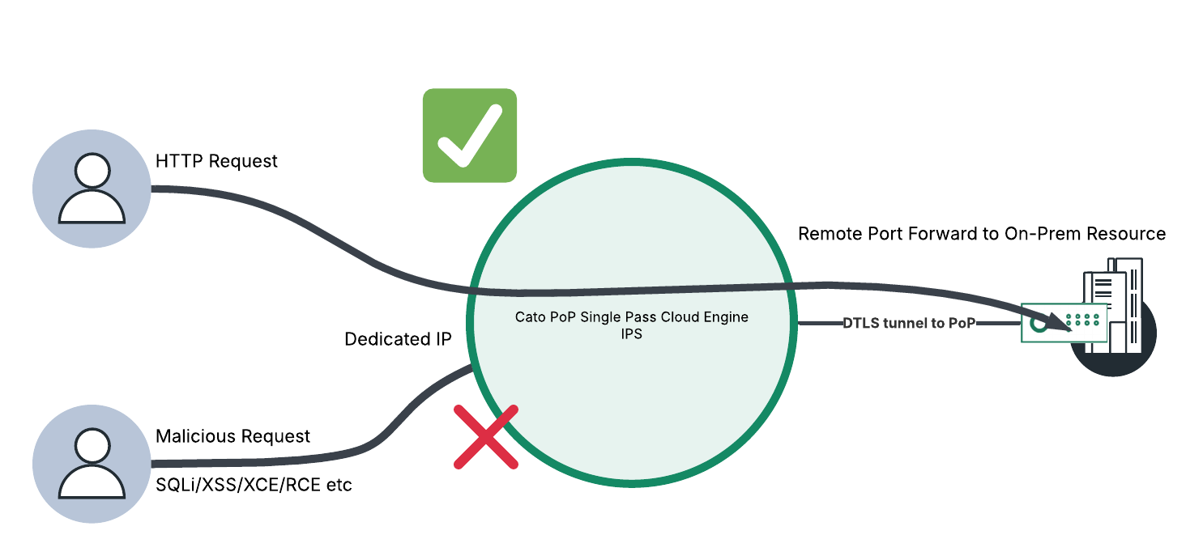
Cato Networks Secure Solution for Exposed Services
Ensuring services are up and protected
Notes:
Leveraging a mix of Cato’s Remote Port Forwarding and leading IPS capabilities, Cato can secure outward facing services to ensure malicious attempts don’t even reach the on-premise equipment. One key benefit is that this solution can be implemented without any infrastructure or network topology changes. No need to deploy firewall appliances onsite.

Slide 9
DEMO

Slide 10
How to
Configure an Allocated IP at a PoP of your choosing
Create a remote port forwarding rule to a HTTP resource (Would recommend using azure / aws tenancy attached to your lab)
Configure/check that IPS inbound is turned on
Review logs/events OR trigger the IPS using a known CVE that we have a signature for to showcase live protection

Slide 11
Thank You!

